Slide 1
Credit Card Fraud Detection Analysis
Utilizing Machine Learning to Understand and Predict Fraudulent Transactions

Slide 2

Contents
Introduction
Main objective and Methodology
Statistical Analysis of Preprocessed Data
Correlation Analysis of Numeric Features
Linear Regression
K-Means Clustering
Evaluating Fraud Detection Accuracy with logistic regression
Model Performance: ROC Curve Analysis
Decision Tree Model for Fraud Detection
Random Forest for Feature Importance
Conclusion

Slide 3

Introduction
Credit card fraud poses a significant challenge in today’s digital economy, leading to substantial financial losses and eroding consumer trust.
Businesses face increased operational costs in managing fraud, while consumers experience breaches of privacy and financial insecurity.
This dual impact underscores the need for advanced detection strategies to safeguard transactions in an ever-evolving digital landscape.

Slide 4

Main Objective and Methodology
The primary goal of our analysis is to identify patterns in fraudulent transactions and leverage these insights to predict future fraud attempts more accurately. This aims to improve existing fraud detection systems by incorporating advanced machine learning techniques.
Our methodology encompasses a comprehensive approach, starting with the collection and preprocessing of transactional data to ensure quality and relevance. We then apply a variety of machine learning models, including Logistic Regression, Random Forest, and Neural Networks, to identify the most effective algorithms for detecting fraudulent activities.
By comparing these models' performance, we aim to enhance the precision and reliability of fraud detection mechanisms.

Slide 5
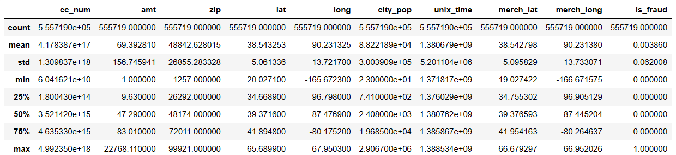
Statistical Analysis of Preprocessed Data
Objective: Analyze the statistical properties of numerical columns after data preprocessing.
Key Actions:
Updated the list of numerical columns to reflect preprocessing adjustments.
Calculated descriptive statistics to summarize the central tendency, dispersion, and shape of the dataset's numerical features.

Slide 6
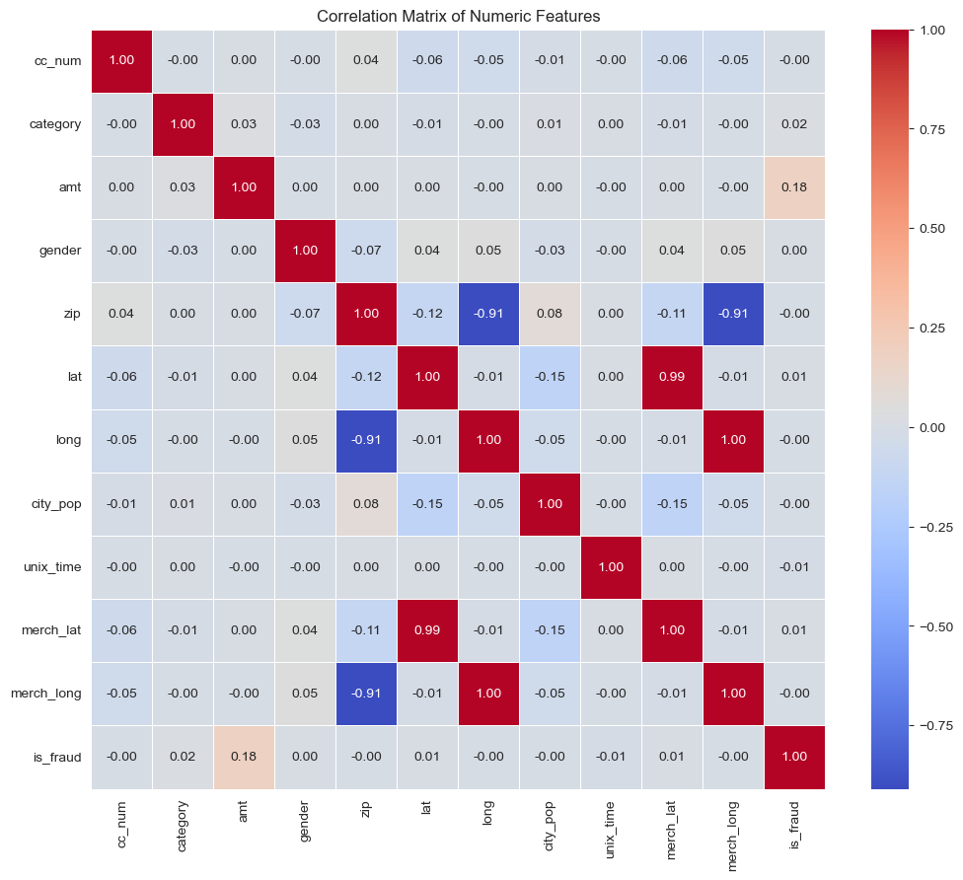
Correlation Analysis of Numeric Features
understanding of the dataset is a crucial step involved in computing and visualizing the correlation matrix for all numeric features.
This analysis is instrumental in identifying potential relationships and dependencies between variables, which can significantly influence our machine learning strategies.

Slide 7
Linear Regression
Our Linear Regression model focused on predicting transaction amounts yielded a Mean Squared Error (MSE) of 26098.55, indicating the average squared difference between the predicted and actual values.
The R-Squared (R²) Score was approximately 0.00, suggesting that the model explains none of the variability in the target variable around its mean. This outcome highlights the challenges in modeling this particular dataset with linear assumptions.
This methodological approach enhances our financial predictions, facilitating more informed decision-making in financial analyses.

Slide 8
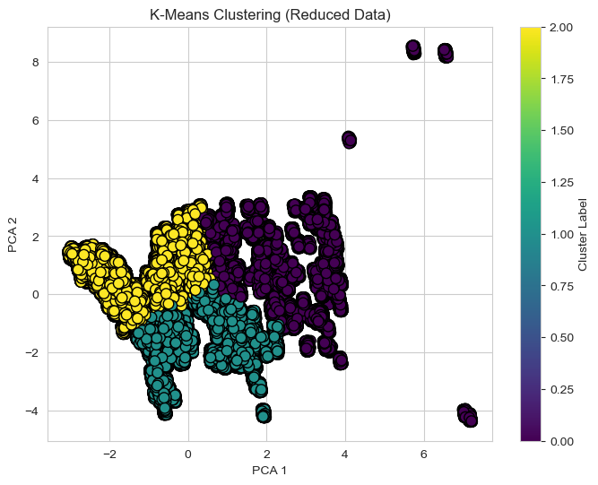
K-Means Clustering
Implementing K-Means Clustering, we scaled our features dataset and determined three distinct clusters.
Post-analysis revealed that the centroids of these clusters differ significantly, hinting at diverse underlying patterns. Visualizing the data reduced via PCA illustrated clear cluster separation, with each cluster potentially representing a unique customer segment.
This insightful differentiation paves the way for targeted strategies that can be tailored to the needs and behaviors of each identified group.

Slide 9
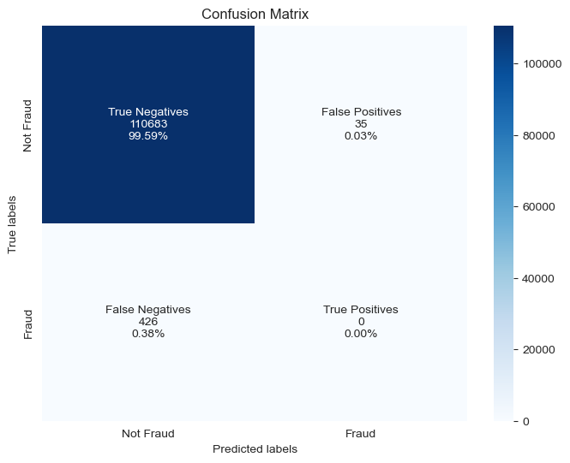
Evaluating Fraud Detection Accuracy with logistic regression
In our predictive analysis of fraudulent transactions, the confusion matrix revealed a high number of true negatives, with 99.59% of non-fraud cases accurately identified. However, the model did not successfully detect any true positives, indicating a potential area for improvement in recognizing fraudulent transactions.
The false negative rate stood at 0.38%, illustrating missed fraud detections, while false positives were minimal at 0.03%. This diagnostic tool underscores the need to enhance our model's sensitivity to fraud detection without compromising its strong ability to identify legitimate transactions.

Slide 10
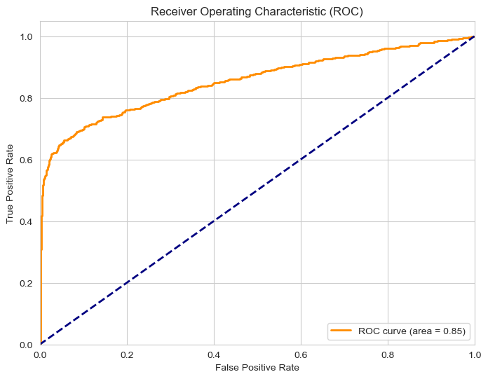
Model Performance: ROC Curve Analysis
Our logistic regression model's capability to differentiate between classes has been quantitatively assessed using the Receiver Operating Characteristic (ROC) curve, yielding an Area Under the Curve (AUC) of 0.85.
This result demonstrates a strong predictive performance, with the model significantly distinguishing between fraudulent and non-fraudulent transactions.
The ROC curve, plotted above, reveals the trade-off between the True Positive Rate and the False Positive Rate at various threshold levels, with our model outperforming a random classifier (indicated by the dashed line).

Slide 11
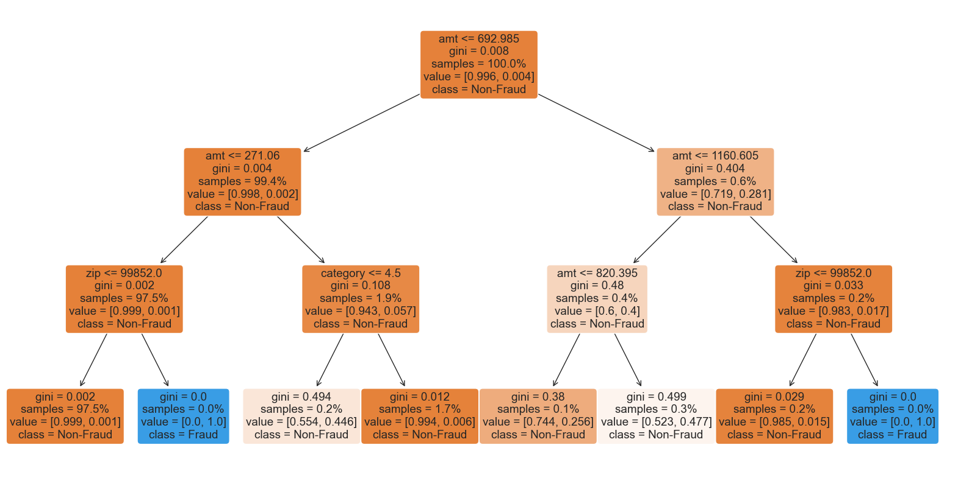
Decision Tree Model for Fraud Detection
The visualized Decision Tree showcases the model's decision-making process when classifying transactions as fraudulent or non-fraudulent. Key decision nodes are based on transaction amount and other influential features, demonstrating the depth and complexity of the analysis.

Slide 12
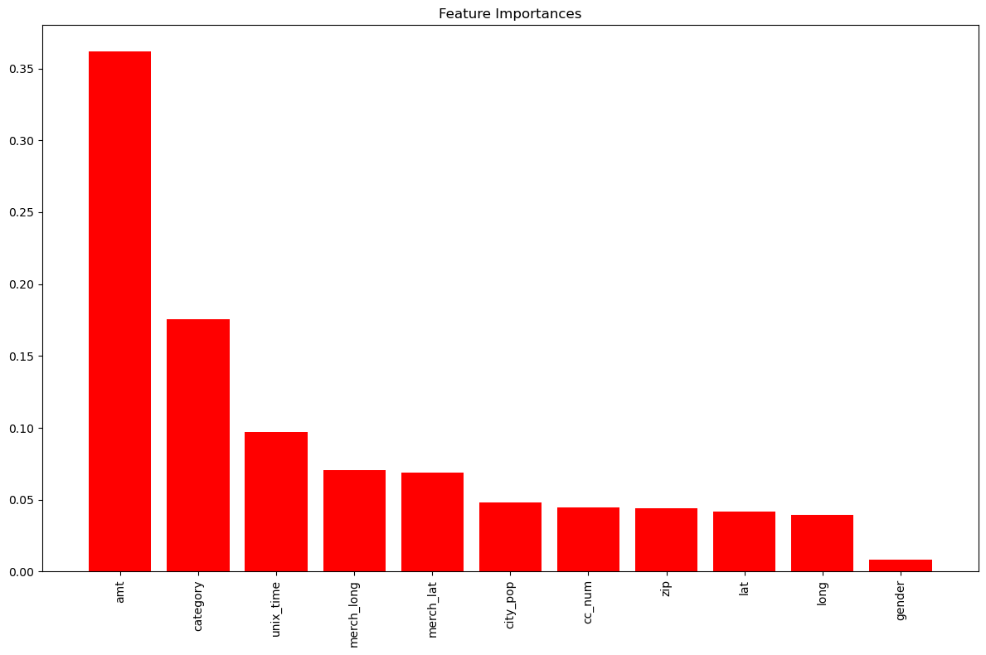
Random Forest for Feature Importance
In our analysis to secure the predictive power of our fraud detection system, we employed a Random Forest Classifier to discern the relative importance of features. Our analysis surfaced 'amt', 'category', and 'unix_time' as top influencers, with 'amt' being the most significant predictor in identifying fraudulent transactions.
The bar chart distinctly showcases these features' contributions to the model, underscoring their critical role in distinguishing fraudulent activities. This insight enables us to focus on the most impactful data points, optimizing both our model's accuracy and computational efficiency.

Slide 13

Conclusion
Concluding our comprehensive analysis using machine learning to detect fraudulent transactions, we’ve exploited a variety of techniques to refine our predictive models.
From in-depth statistical assessments to advanced machine learning algorithms, such as Logistic Regression and Random Forest, we've extracted valuable insights. The models pinpointed critical predictors of fraud, highlighted by feature importance analysis, and displayed strong classification capabilities, as evidenced by the ROC curve.
Despite these advances, the confusion matrix suggests further improvement is needed in true positive detection. Overall, our endeavors have laid a solid groundwork for developing a robust fraud detection system, with ongoing optimization covers the way for even more precise and reliable fraud identification in the future.

Slide 14


